Slide 1

KS3 Mathematics
A6 Interpreting graphs
Notes:
The aim of this unit is to teach pupils to:
Construct functions arising from real-life problems, and plot and interpret their corresponding graphs
Material in this unit is linked to the Key Stage 3 Framework supplement of examples pp 172-177.

Slide 2


Interpreting the shapes of graphs
Jessica eats a bar of chocolate. This graph shows how the mass of the chocolate bar changes as it is eaten.
150
Eating a bar of chocolate
100
Mass of chocolate (g)
50
0
0
10
20
30
40
50
60
70
80
90
100
Time (seconds)
Notes:
Discuss the graph and ask the following questions:
What do the vertical portions of the graph represent?
What do the horizontal portions of the graph represent?
How many bites did it take to finish the bar?
What was the weight of the biggest bite?
How long did it take Jessica to eat the first bite?
What is the original weight of the chocolate bar?
How long did Jessica take to finish the chocolate bar in seconds/in minutes and seconds?

Slide 3
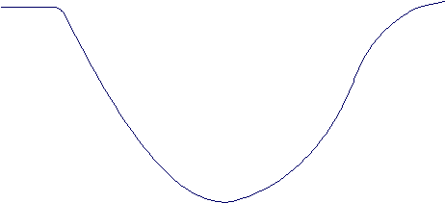
Interpreting the shapes of graphs
This graphs shows how the temperature of the water in a pan changes when frozen peas are added.
Temperature of water
Time
Notes:
Ask a volunteer to point to the point on the graph that shows when the peas are added to the water.
Discuss trends in the graph. Ask pupils to describe what is happening in the portion of the graph that slopes downwards. Ask also what is happening in the portion of the graph that slopes upwards.
Ask pupils to describe what is happening at each turning point in the graph.

Slide 4
Which graph is correct?
In an experiment a group of pupils poured water onto a sponge and weighed it at regular intervals.
Each time the sponge soaked up all the water.
Which graph is most likely to show their results?
Graph A
Graph B
Graph C
Graph D
Mass of sponge (g)
Mass of sponge (g)
Mass of sponge (g)
Mass of sponge (g)
Volume of water (cm³)
Volume of water (cm³)
Volume of water (cm³)
Volume of water (cm³)
Notes:
Ask pupils to justify their choice of graph to fit the situation.

Slide 5
Sketching graphs
A group of pupils are conducting an experiment. They fill three beakers with boiling water and record the temperature of the water over time.
Beaker A has no wrapping, Beaker B is wrapped in ice and Beaker C is wrapped in insulation fibre.
The temperature graph for beaker A looks as follows:
How would the graphs for beakers B and C compare to this?
Temperature (ºC)
Beaker A
Time (minutes)
Notes:
Ask pupils to describe what the graph for beaker A shows. Agree that it shows the water cooling rapidly and then cooling more slowly. Ask pupils how the graphs for beakers B and beaker C will differ from the one shown.
Use the next slide to sketch these different graphs.

